Slide 1
System Programming
CSE 401
(lecture 4)
Md.Julkar Nayeen Mahi
Lecturer, City University

Slide 2
Bus-Based Computer Systems
Busses.
Memory devices.
I/O devices:
  serial links
  timers and counters
  keyboards
  displays
  analog I/O
© 2008 Morgan Kaufman
Computers as Components Wayne Wolf

Slide 3
The CPU bus
Bus allows CPU, memory, devices to communicate.
  Shared communication medium.
A bus is:
  A set of wires.
  A communications protocol.
© 2008 Morgan Kaufman
Computers as Components Wayne Wolf

Slide 4
Bus protocols
Bus protocol determines how devices communicate.
Devices on the bus go through sequences of states.
  Protocols are specified by state machines, one state machine per actor in the protocol.
May contain asynchronous logic behavior.
© 2008 Morgan Kaufman
Computers as Components Wayne Wolf

Slide 5
Four-cycle handshake
device 1
enq
device 1
device 2
ack
device 2
1
2
3
4
time
© 2008 Morgan Kaufman
Computers as Components Wayne Wolf

Slide 6
Four-cycle handshake, cont’d.
Device 1 raises enq.
Device 2 responds with ack.
Device 2 lowers ack once it has finished.
Device 1 lowers enq.
© 2008 Morgan Kaufman
Computers as Components Wayne Wolf

Slide 7
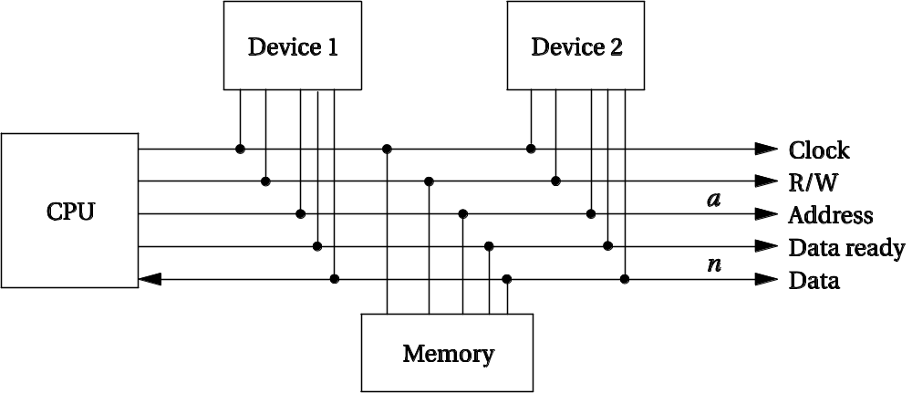
Microprocessor busses
Clock provides synchronization.
R/W is true when reading (R/W’ is false when reading).
Address is a-bit bundle of address lines.
Data is n-bit bundle of data lines.
Data ready signals when n-bit data is ready.
© 2008 Morgan Kaufman
Computers as Components Wayne Wolf

Slide 8
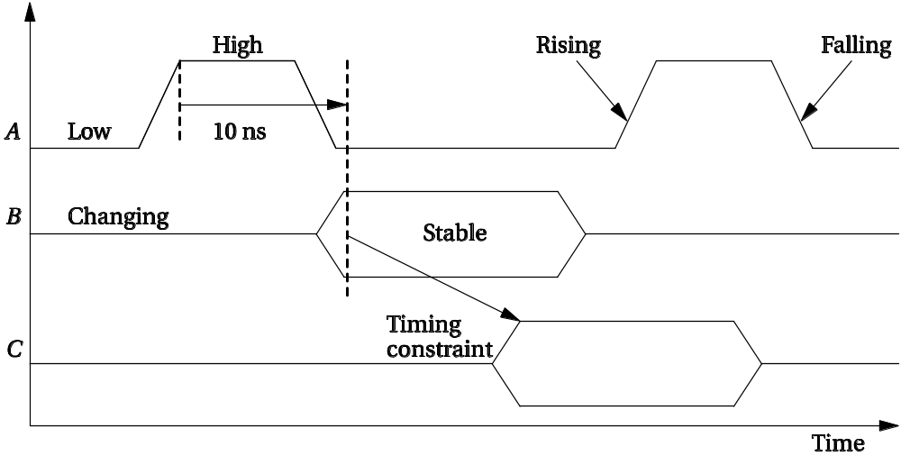
Timing diagrams
© 2008 Morgan Kaufman
Computers as Components Wayne Wolf

Slide 9
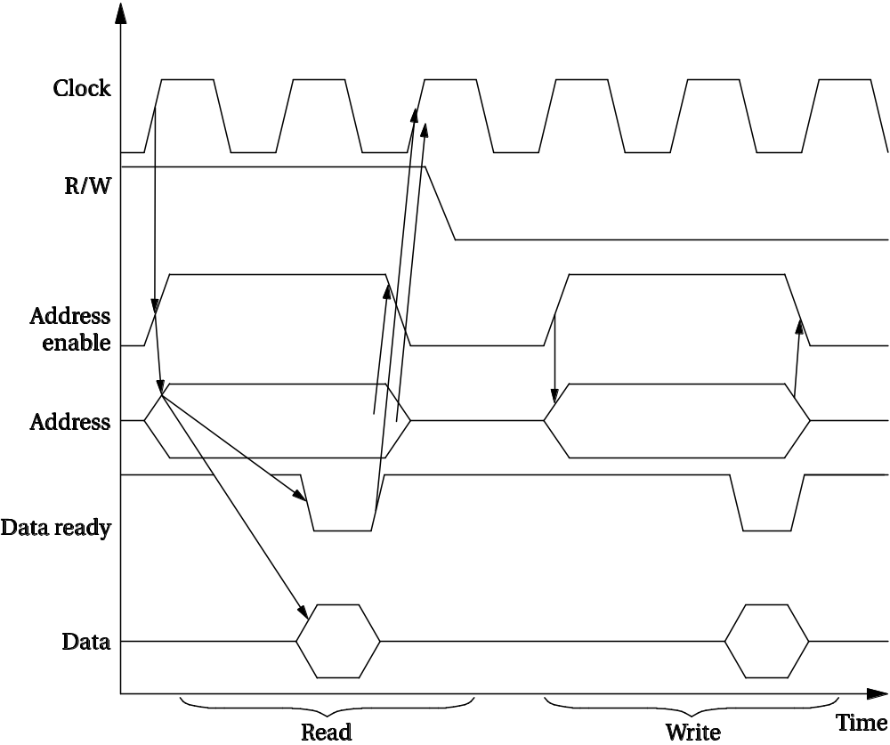
Bus read
© 2008 Morgan Kaufman
Computers as Components Wayne Wolf

Slide 10
State diagrams for bus read
Get data
Done
Senddata
Release ack
See ack
Ack
Adrs
Adrs
Wait
Wait
device
CPU
start
© 2008 Morgan Kaufman
Computers as Components Wayne Wolf

Slide 11
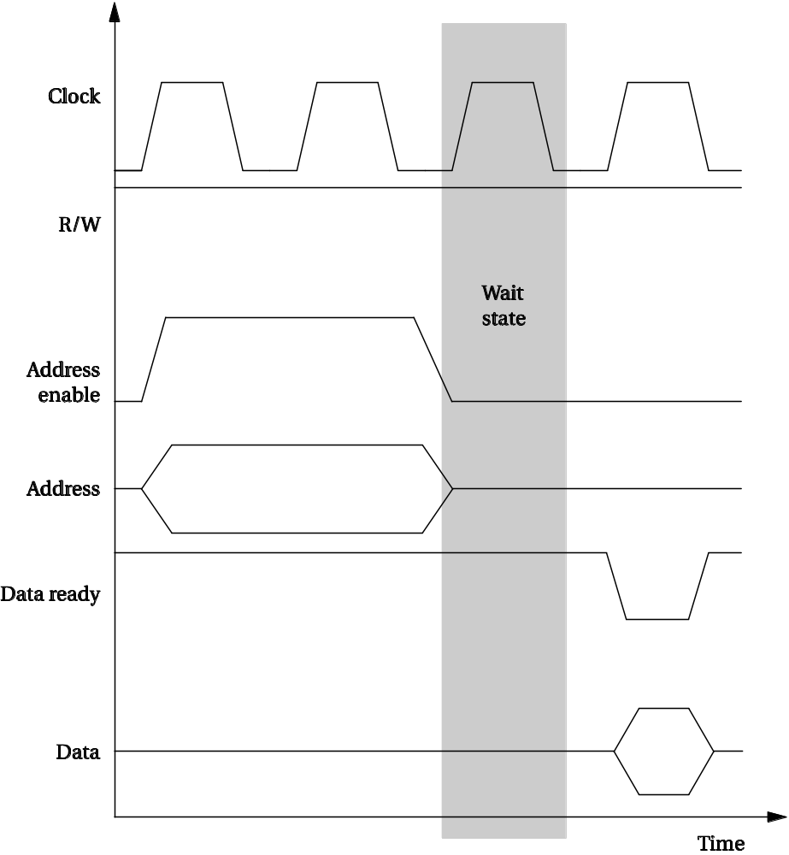
Bus wait state
© 2008 Morgan Kaufman
Computers as Components Wayne Wolf

Slide 12
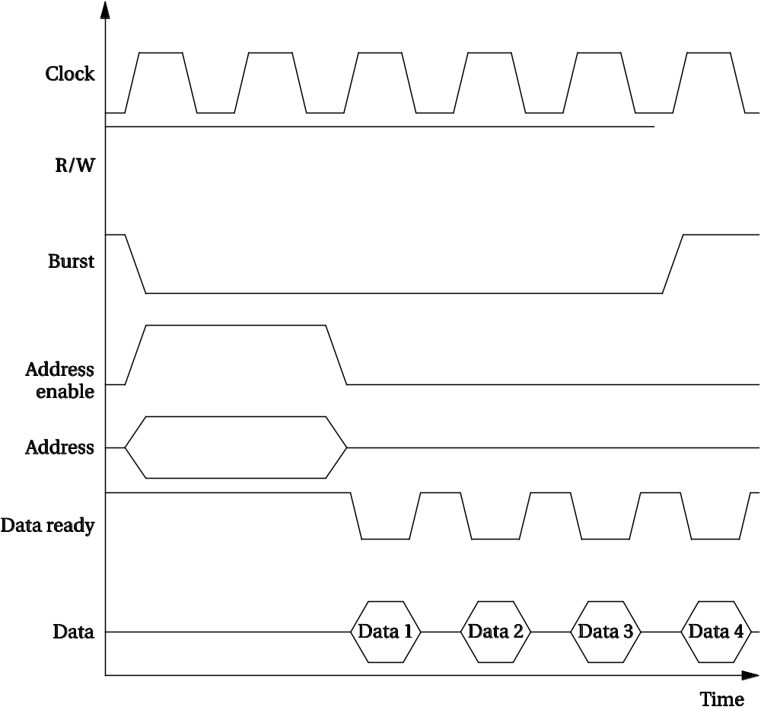
Bus burst read
© 2008 Morgan Kaufman
Computers as Components Wayne Wolf

Slide 13
Bus multiplexing
data enable
device
CPU
data
adrs
adrs
Adrs enable
© 2008 Morgan Kaufman
Computers as Components Wayne Wolf

Slide 14
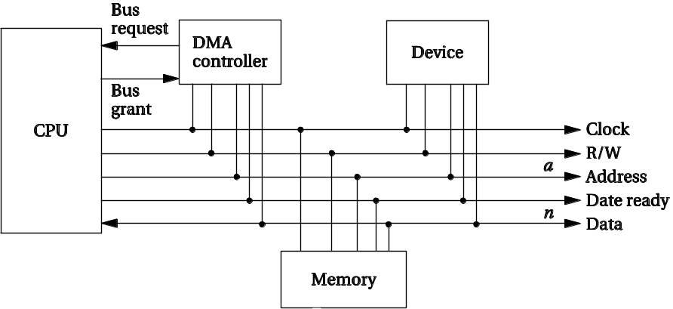
DMA
Direct memory access (DMA) performs data transfers without executing instructions.
  CPU sets up transfer.
  DMA engine fetches, writes.
DMA controller is a separate unit.
© 2008 Morgan Kaufman
Computers as Components Wayne Wolf

Slide 15
Bus mastership
By default, CPU is bus master and initiates transfers.
DMA must become bus master to perform its work.
  CPU can’t use bus while DMA operates.
Bus mastership protocol:
  Bus request.
  Bus grant.
© 2008 Morgan Kaufman
Computers as Components Wayne Wolf

Slide 16
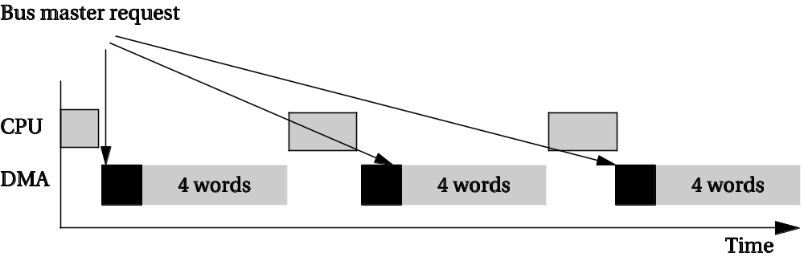
DMA operation
CPU sets DMA registers for start address, length.
DMA status register controls the unit.
Once DMA is bus master, it transfers automatically.
  May run continuously until complete.
  May use every n^{th} bus cycle.
© 2008 Morgan Kaufman
Computers as Components Wayne Wolf

Slide 17
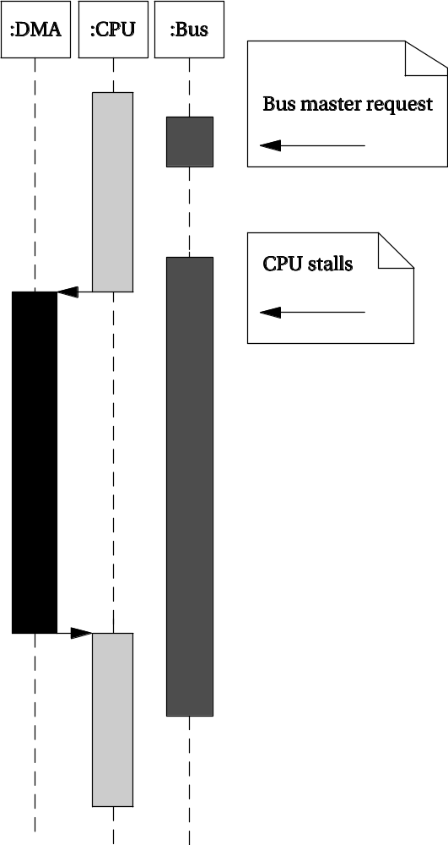
Bus transfer sequence diagram
© 2008 Morgan Kaufman
Computers as Components Wayne Wolf

Slide 18
System bus configurations
Multiple busses allow parallelism:
  Slow devices on one bus.
  Fast devices on separate bus.
A bridge connects two busses.
CPU
slow device
bridge
memory
slow device
high-speed
device
© 2008 Morgan Kaufman
Computers as Components Wayne Wolf

Slide 19
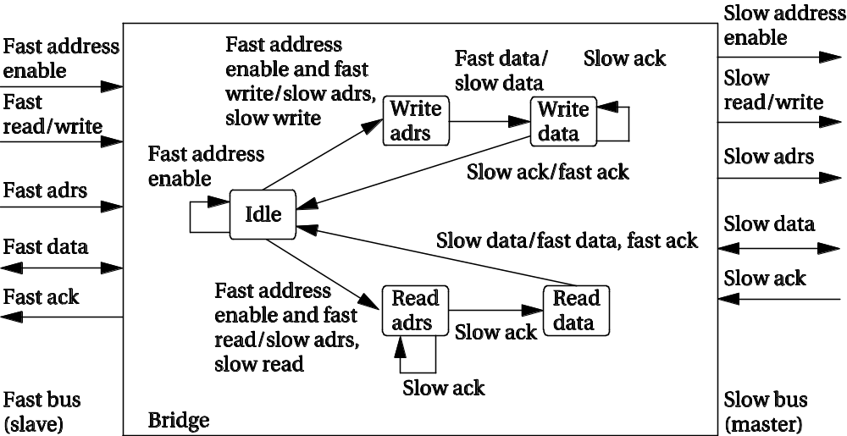
Bridge state diagram
© 2008 Morgan Kaufman
Computers as Components Wayne Wolf

Slide 20
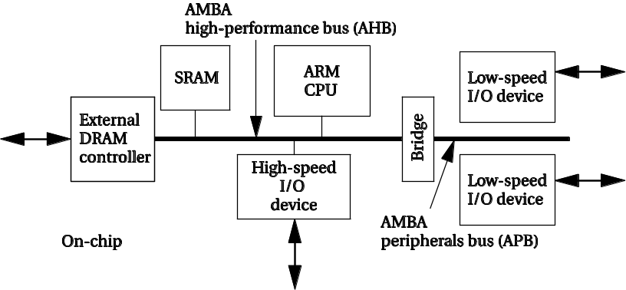
ARM AMBA bus
Two varieties:
  AHB is high-performance.
  APB is lower-speed, lower cost.
AHB supports pipelining, burst transfers, split transactions, multiple bus masters.
All devices are slaves on APB.
© 2008 Morgan Kaufman
Computers as Components Wayne Wolf

Slide 21
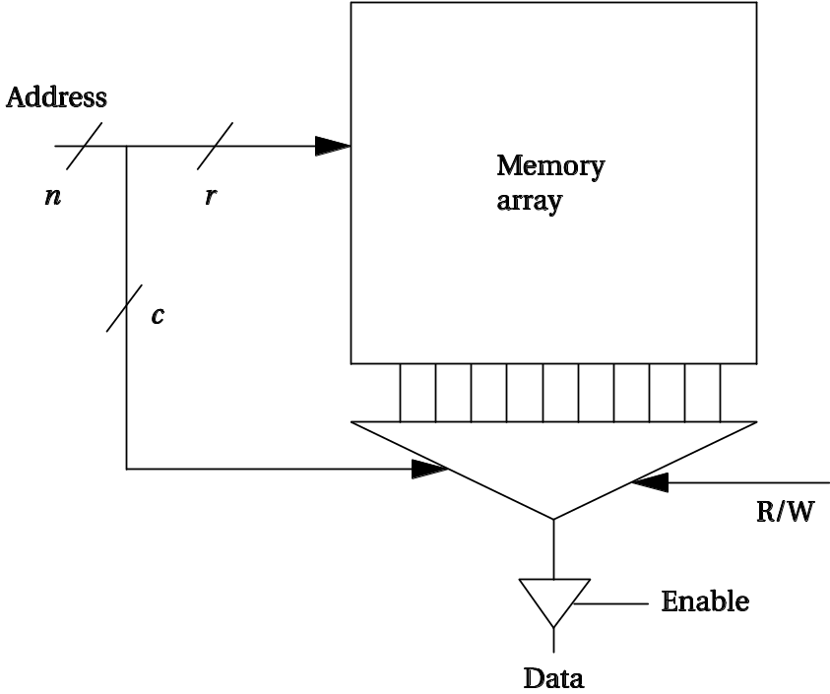
Memory components
Several different types of memory:
  DRAM.
  SRAM.
  Flash.
Each type of memory comes in varying:
  Capacities.
  Widths.
© 2008 Morgan Kaufman
Computers as Components Wayne Wolf

Slide 22
Random-access memory
Dynamic RAM is dense, requires refresh.
  Synchronous DRAM is dominant type.
  SDRAM uses clock to improve performance, pipeline memory accesses.
Static RAM is faster, less dense, consumes more power.
© 2008 Morgan Kaufman
Computers as Components Wayne Wolf

Slide 23
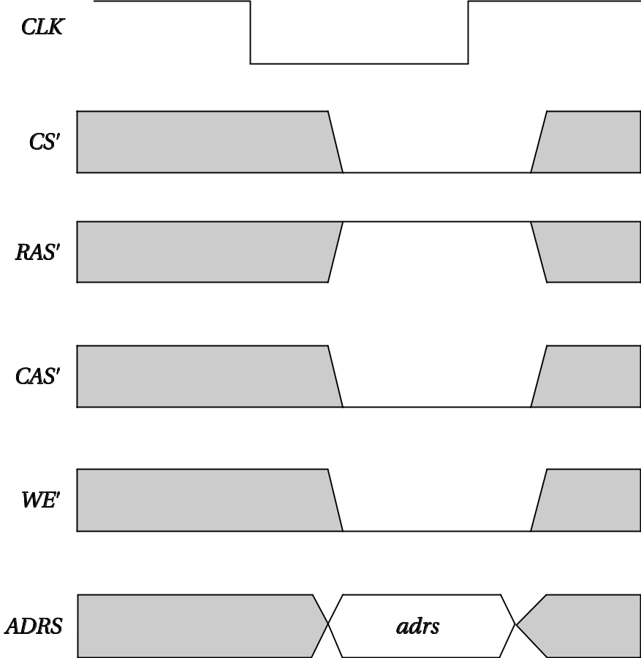
SDRAM operation
© 2008 Morgan Kaufman
Computers as Components Wayne Wolf

Slide 24
Read-only memory
ROM may be programmed at factory.
Flash is dominant form of field-programmable ROM.
  Electrically erasable, must be block erased.
  Random access, but write/erase is much slower than read.
  NOR flash is more flexible.
  NAND flash is more dense.
© 2008 Morgan Kaufman
Computers as Components Wayne Wolf

Slide 25
Timers and counters
Very similar:
  a timer is incremented by a periodic signal;
  a counter is incremented by an asynchronous, occasional signal.
Rollover causes interrupt.
© 2008 Morgan Kaufman
Computers as Components Wayne Wolf

Slide 26
Watchdog timer
Watchdog timer is periodically reset by system timer.
If watchdog is not reset, it generates an interrupt to reset the host.
host CPU
interrupt
watchdog
timer
reset
© 2008 Morgan Kaufman
Computers as Components Wayne Wolf

Slide 27
Switch debouncing
A switch must be debounced to multiple contacts caused by eliminate mechanical bouncing:
© 2008 Morgan Kaufman
Computers as Components Wayne Wolf

Slide 28
Encoded keyboard
An array of switches is read by an encoder.
N-key rollover remembers multiple key depressions.
row
© 2008 Morgan Kaufman
Computers as Components Wayne Wolf

Slide 29
LED
Must use resistor to limit current:
© 2008 Morgan Kaufman
Computers as Components Wayne Wolf

Slide 30
7-segment LCD display
May use parallel or multiplexed input.
© 2008 Morgan Kaufman
Computers as Components Wayne Wolf

Slide 31
Types of high-resolution display
Liquid crystal display (LCD) is dominant form.
Plasma, OLED, etc.
Frame buffer holds current display contents.
  Written by processor.
  Read by video.
© 2008 Morgan Kaufman
Computers as Components Wayne Wolf

Slide 32
Touchscreen
Includes input and output device.
Input device is a two-dimensional voltmeter:
© 2008 Morgan Kaufman
Computers as Components Wayne Wolf

Slide 33
Touchscreen position sensing
ADC
voltage
© 2008 Morgan Kaufman
Computers as Components Wayne Wolf

Slide 34
Digital-to-analog conversion
Use resistor tree:
R
V_{out}
b_{n}
2R
b_{n-1}
4R
b_{n-2}
8R
b_{n-3}
© 2008 Morgan Kaufman
Computers as Components Wayne Wolf

Slide 35
Flash A/D conversion
N-bit result requires 2^{n} comparators:
V_{in}
encoder
...
© 2008 Morgan Kaufman
Computers as Components Wayne Wolf

Slide 36
Dual-slope conversion
Use counter to time required to charge/discharge capacitor.
Charging, then discharging eliminates non-linearities.
V_{in}
timer
© 2008 Morgan Kaufman
Computers as Components Wayne Wolf

Slide 37
Sample-and-hold
Samples data:
converter
V_{in}
© 2008 Morgan Kaufman
Computers as Components Wayne Wolf

